Slide 1
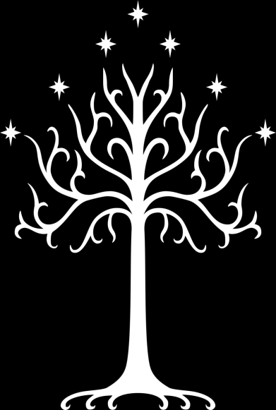
Gondor & The Realms of Men

Slide 2
A Brief Recap
What is Gondor?
What does it represent?
The history of men
Men in decline
Men in ascension
How does Howard Shore convey these ideas?

Slide 3
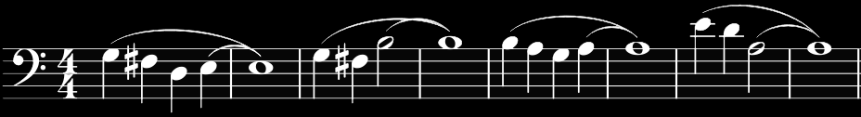
The History Of Men
Everything that mankind can be, should it choose a nobler path

